Slide 1
https://www.youtube.com/watch?v=BpNxRsIoN58

Slide 2
Avalanche Safety
Technology and Psychology

Slide 3
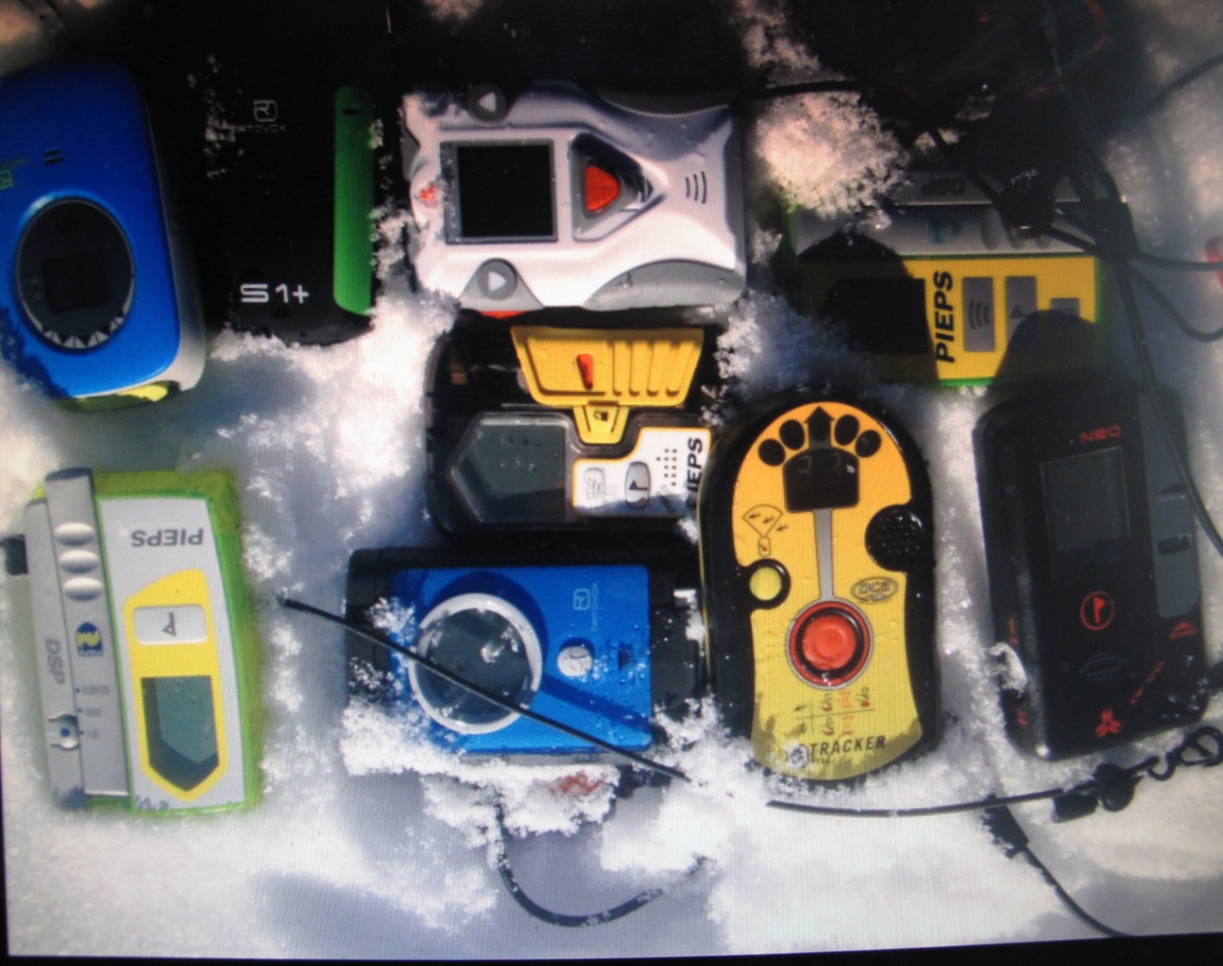
Transceivers
1. Improved range.
2. Multiple burial features.
3. Increased speed of processing.
4. Some automation (Pieps Micro).
5. Pulse.

Slide 4
Transceivers issues.
Some signal suppression failure of up to 70% with multiple burials in excess of 3.
Should groups be smaller?
10-15% fatality reduction
Professionals have reduced their fatality rate by 60-70%
Technical pressure to innovate increases complexity to use.
“The best avalanche transceiver is the one that you know how to use!”

Slide 5
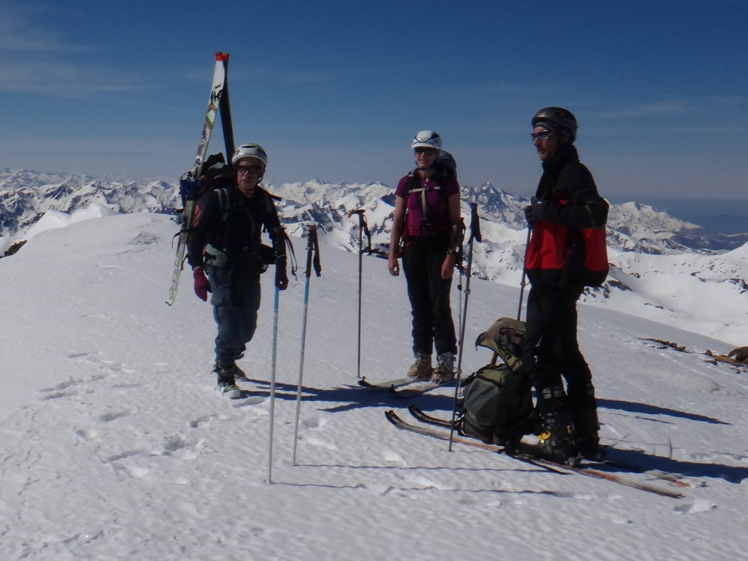
Helmets
Better Designed
Lighter
Deal with avalanche trauma fatalities:
50% Canada
25% USA
6% Europe
No significant reduction in head injuries despite 90+% take up on and near piste.

Slide 6
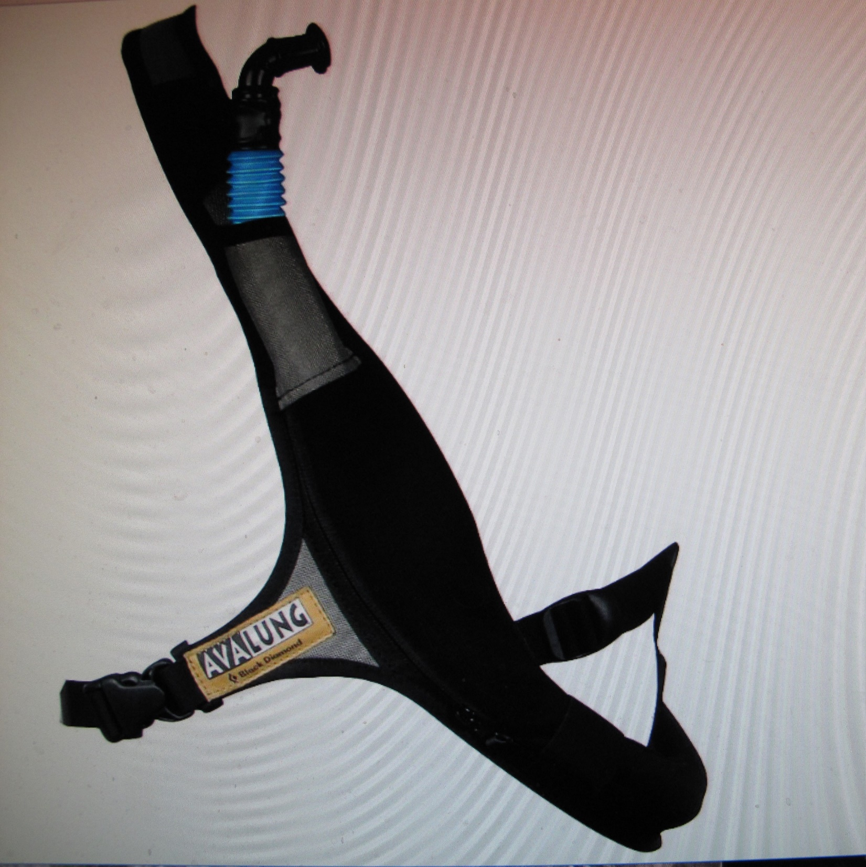
Avalung
Deals with asphyxiation issue by buying you time.
Simple.
Lighter, smaller.
Design developments –
Built into rucksack straps.
Have to get it into your mouth when you’re in the avalanche

Slide 7
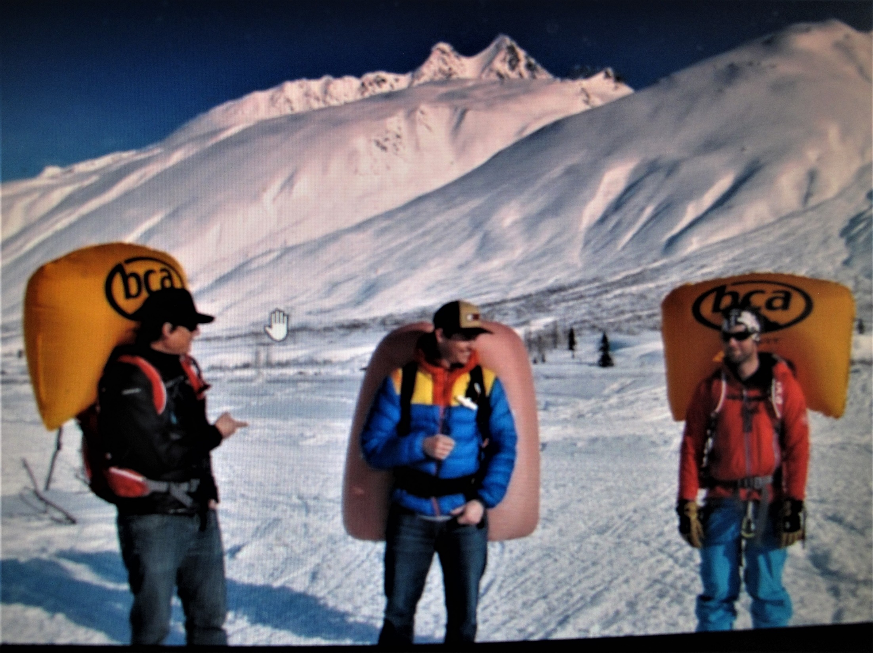
Airbags
Work!
10% of avalanche
victims without airbags die even with transceivers.
Only 1.5% using airbags die.

Slide 8
Airbag issues:
Weight
Testing
Flight regulations.
Replacement of inflation canisters.
Lighter 2kg
Fan inflated so no canister.
Compressed air rather than compressed nitrogen
makes refilling easier.

Slide 9
Psychology
Facts:
In 93% of avalanche accidents the avalanche is triggered by the victim or someone in his party.
93% of avalanche victims are male whilst only 7% are female.
“We have met the enemy and he is us.”
Risk Homeostasis

Slide 10
Heuristics are mental shortcuts that mean we respond more quickly but not rationally, influenced by:
Familiarity
Acceptance (seeking this from others.)
Commitment (to a goal or image/identity.)
Expert halo.
Scarcity (competition for resources or among others.)
Social proof (the herding instinct.)

Slide 11
Other psychological factors.
Belief is psychologically easier than scepticism.
“When the facts change, it’s time to change your mind.”- Keynes.
“Not knowing is true knowledge. Presuming to know is a disease.”- Lao Tsu.
Communication – “groups of people almost always make better decisions than individuals.” Needs: 1. Some shared expertise.
2. Diversity of opinions.
3. Freely competing ideas.
4. A means of resolving disagreement eg voting.

Slide 12
Avalanche technology deals with avalanche accidents. Avalanche psychology is about avalanche avoidance.

